Slide 1
Data Science
CSE-4075
(Data Preprocessing)

Slide 2
Outline
Overview of data preparation & preprocessing techniques
Data integration, smoothing, redundant attributes
Normalization
Data reduction
Dividing the data
Resampling techniques

Slide 3
Examples of data science tasks
Classification
Estimation
Prediction
Characterization
Discrimination
Affinity grouping
Clustering
Time series analysis

Slide 4
Why do we need to prepare the data?
Data in the real world is dirty
incomplete: lacking attribute values, lacking certain attributes of interest, or containing only aggregate data
noisy: containing errors or outliers
inconsistent: containing discrepancies in codes or names
No quality data, no quality results!
Quality decisions must be based on quality data
Data warehouse needs consistent integration of quality data
A multi-dimensional measure of data quality:
A well-accepted multi-dimensional view:
accuracy, completeness, consistency, timeliness, believability, value added, interpretability, accessibility
Broad categories:
intrinsic, contextual, representational, and accessibility.

Slide 5
Major Tasks in Data Preprocessing
Data cleaning
Fill in missing values, smooth noisy data, identify or remove outliers, and resolve inconsistencies
Data integration
Integration of multiple databases, data cubes, files, or notes
Data transformation
Normalization (scaling to a specific range)
Aggregation
Data reduction
Obtains reduced representation in volume but produces the same or similar analytical results
Data discretization: with particular importance, especially for numerical data
Data aggregation, dimensionality reduction, data compression,generalization

Slide 6
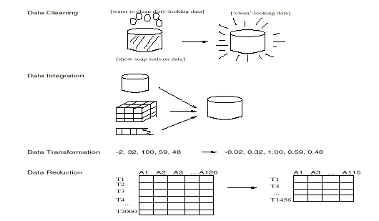
Forms of data preprocessing

Slide 7
Data Cleaning Tasks
Fill in missing values
Identify outliers and smooth out noisy data
Correct inconsistent data
Remove irrelevant data

Slide 8
Missing Data
Data is not always available
E.g., many tuples have no recorded value for several attributes, such as customer income in sales data
Missing data may be due to
equipment malfunction
inconsistent with other recorded data and thus deleted
data not entered due to misunderstanding
certain data may not be considered important at the time of entry
not register history or changes of the data
Missing data may need to be inferred

Slide 9
How to Handle Missing Data?
Ignore the tuple usually done when class label is missing (assuming the task is classification—not effective in certain cases)
Fill in the missing value manually: tedious + infeasible?
Use a global constant to fill in the missing value: e.g., “unknown”, a new class?!
Use the attribute mean to fill in the missing value
Use the attribute mean for all samples of the same class to fill in the missing value: smarter
Use the most probable value to fill in the missing value: inference-based such as regression, Bayesian formula, decision tree

Slide 10
Noisy Data
Q: What is noise?
A: Random error in a measured variable.
Incorrect attribute values may be due to
faulty data collection instruments
data entry problems
data transmission problems
technology limitation
inconsistency in naming convention
Other data problems which requires data cleaning
duplicate records
incomplete data
inconsistent data

Slide 11
How to Handle Noisy Data?
Binning method:
first sort data and partition into (equi-depth) bins
then one can smooth by bin means, smooth by bin median, smooth by bin boundaries, etc.
used also for discretization (discussed later)
Clustering
detect and remove outliers
Semi-automated method: combined computer and human inspection
detect suspicious values and check manually
Regression
smooth by fitting the data into regression functions

Slide 12
Simple Discretization Methods: Binning
Equal-depth
Equal-width
Value | Equal-depth [2 depth] | Equal-width [10 width]
7 | [7, 20] | [0-10]
20 | [7, 20] | [11-20]
22 | [22, 50] | [21-30]
50 | [22, 50] | [41-50]
51 | [51, 53] | [51-60]
53 | [51, 53] | [51-60]

Slide 13
Simple Discretization Methods: Binning
Equal-width (distance) partitioning:
It divides the range into N intervals of equal size: uniform grid
if A and B are the lowest and highest values of the attribute, the width of intervals will be: W = (B-A)/N.
The most straightforward
But outliers may dominate presentation
Skewed data is not handled well.
Equal-depth (frequency) partitioning:
It divides the range into N intervals, each containing approximately same number of samples
Good data scaling
Managing categorical attributes can be tricky.

Slide 14
Binning Methods for Data Smoothing
* Sorted data:
4, 8, 9, 15, 21, 21, 24, 25, 26, 28, 29, 34
* Partition into (equi-depth) bins:
- Bin 1:
4, 8, 9, 15
- Bin 2:
21, 21, 24, 25
- Bin 3:
26, 28, 29, 34
* Smoothing by bin means:
- Bin 1:
9, 9, 9, 9
- Bin 2:
23, 23, 23, 23
- Bin 3:
29, 29, 29, 29
* Smoothing by bin boundaries:
- Bin 1:
4, 4, 4, 15
- Bin 2:
21, 21, 25, 25
- Bin 3:
26, 26, 26, 34

Slide 15
Smoothing through Clustering
Replace each data value with a cluster representative (“+” in the following case)

Slide 16
Smoothing through Regression
Replace each data value with the regressed value (“y” in the following case)
y
Y1
Y1’
y = x + 1
X1
x
Linear regression (best line to fit
two variables)
Multiple linear regression (more
than two variables, fit to a
multidimensional surface

Slide 17
How to Handle Inconsistent Data?
Manual correction using external references
Semi-automatic using various tools
To detect violation of known functional dependencies and data constraints
To correct redundant data

Slide 18
Data Integration
Data integration:
combines data from multiple sources into a coherent store
Schema integration
integrate metadata from different sources
Entity identification problem: identify real world entities from multiple data sources, e.g., A.cust-id ≡ B.cust-#
Detecting and resolving data value conflicts
for the same real world entity, attribute values from different sources are different
possible reasons: different representations, different scales, e.g., metric vs. British units, different currency

Slide 19
Handling Redundant Data in Data Integration
Redundant data occur often when integrating multiple DBs
The same attribute may have different names in different databases
One attribute may be a “derived” attribute in another table, e.g., annual revenue
Redundant data may be able to be detected by correlational analysis
Careful integration can help reduce/avoid redundancies and inconsistencies and improve mining speed and quality

Slide 20

Handling Redundant Data in Data Integration
Redundant data may be able to be detected by correlational analysis
Let A and B be two values(events or attributes)
Probabilities are P(A) and P(B)
If A and B are independent, then P(AᴧB) = P(A)×P(B)
So
$$\frac{P\left(AΛB\right)}{P\left(A\right)×P\left(B\right)}= \left\{\begin{matrix}1:Independent \\ >1:Positively_Correlated \\ <1:Negatively_Correlated\end{matrix}\right\}$$

Slide 21
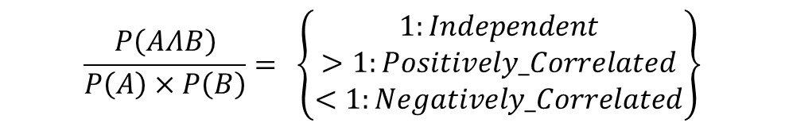
Handling Redundant Data in Data Integration
$$\frac{P\left(AΛB\right)}{P\left(A\right)×P\left(B\right)}= \left\{\begin{matrix}1:Independent \\ >1:Positively_Correlated \\ <1:Negatively_Correlated\end{matrix}\right\}$$
A | 1 | 1 | 1 | 1 | 0 | 0 | 0 | 0
B | 1 | 1 | 0 | 0 | 0 | 0 | 0 | 0
C | 1 | 1 | 1 | 1 | 1 | 1 | 1 | 1
Correlation (A,B): (2/8)/[(4/8)×(2/8)]= 2
Implies A and B are correlated, since, Correlation (A,B) >1
Attributes | Correlation Value | Conclusion
A,B | 2 | Positively correlated
A,C | 0.9 | Negatively correlated
B,C | 0.57 | Negatively correlated

Slide 22
Data Transformation
Smoothing: remove noise from data (binning, clustering, regression)
Normalization: scaled to fall within a small, specified range
min-max normalization
z-score normalization
normalization by decimal scaling
Aggregation: summarization, data cube construction
Generalization: concept hierarchy climbing
Attribute/feature construction
New attributes constructed from the given ones

Slide 23
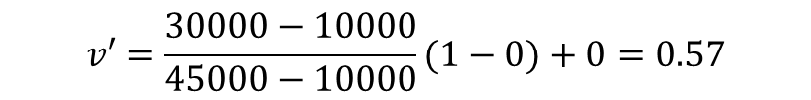
Data Transformation: Normalization
Min-max normalization
Example: transform v = $30,000 into 0<=v’<=1, where v ranges between 10,000 and 45,000.
Min-max normalization preserves all relationships of data values exactly and does not introduce any potential biases.
If a future input case falls outside the original data range, an “out of bounds” error will occur.
$$v′=\frac{30000−10000}{45000−10000}(1−0)+0=0.57$$

Slide 24
Data Transformation: Normalization
z-score normalization

Slide 25
Data Transformation: Normalization
z-score normalization
Works well when actual minimum/maximum values are unknown, or outlier values are present.
normalization by decimal scaling
e.g. if v ranges between -98 and 9738, then j = 4 means that v’ ranges between -0.0098 and 0.9738
Where j is the smallest integer such that Max(| |)<1

Slide 26
Data Reduction
Problem:
Data Warehouse may store terabytes of data: Complex data analysis/mining may take a very long time to run on the complete data set
Solution?
Data reduction…

Slide 27
Data Reduction
Obtains a reduced representation of the data set that is much smaller in volume but yet produces the same (or almost the same) analytical results
Data reduction strategies
Data cube aggregation
Dimensionality reduction
Data compression
Numerosity reduction
Discretization and concept hierarchy generation

Slide 28
Data Cube Aggregation
Multiple levels of aggregation in data cubes
Further reduce the size of data to deal with
Reference appropriate levels
Use the smallest representation capable to solve the task
Queries regarding aggregated information should be answered using data cube, when possible

Slide 29
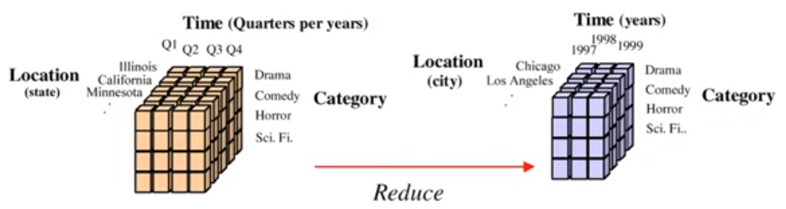
Data Cube Aggregation

Slide 30
Dimensionality Reduction
Problem: Feature selection (i.e., attribute subset selection):
Select a minimum set of features such that the probability distribution of different classes given the values for those features is as close as possible to the original distribution given the values of all features
Nice side-effect: reduces # of attributes in the discovered patterns (which are now easier to understand)
Solution: Heuristic methods (due to exponential # of choices) usually greedy:
step-wise forward selection
step-wise backward elimination
combining forward selection and backward elimination
decision-tree induction

Slide 31
Example of Decision Tree Induction
nonleaf nodes: tests
branches: outcomes of tests
leaf nodes: class prediction
Initial attribute set:
{A1, A2, A3, A4, A5, A6}
A4 ?
A1?
A6?
Class 1
Class 2
Class 1
Class 2
>
Reduced attribute set: {A1, A4, A6}

Slide 32
Data Compression
String compression
There are extensive theories and well-tuned algorithms
Typically lossless
But only limited manipulation is possible without expansion
Audio/video, image compression
Typically lossy compression, with progressive refinement
Sometimes small fragments of signal can be reconstructed without reconstructing the whole
Time sequence is not audio
Typically short and vary slowly with time

Slide 33
Data Compression
Original Data
Compressed
Data
lossless
Original Data
Approximated
lossy

Slide 34
Principal Component Analysis (PCA)
Given N data vectors from k-dimensions, find
c <= k orthogonal vectors that can be best used to represent data
The original data set is reduced (projected) to one consisting of N data vectors on c principal components (reduced dimensions)
Each data vector is a linear combination of the c principal component vectors
Works for ordered and unordered attributes
Used when the number of dimensions is large

Slide 35
Principal Component Analysis
The principal components (new set of axes) give important information about variance.
Using the strongest components one can reconstruct a good approximation of the original signal.
X2
Y1
Y2
X1

Slide 36
Numerosity Reduction
Parametric methods
Assume the data fits some model, estimate model parameters, store only the parameters, and discard the data (except possible outliers)
Non-parametric methods
Do not assume models
Major families: histograms, clustering, sampling

Slide 37
Regression and Log-Linear Models
Linear regression: Data are modeled to fit a straight line:
Often uses the least-square method to fit the line
Multiple regression: allows a response variable y to be modeled as a linear function of multidimensional feature vector (predictor variables)
Log-linear model: approximates discrete multidimensional joint probability distributions

Slide 38
Regression Analysis and Log-Linear Models
Linear regression: Y = α + β X
Two parameters , α and β specify the line and are to be estimated by using the data at hand.
using the least squares criterion to the known values of Y1, Y2, …, X1, X2, ….
Multiple regression: Y = b0 + b1 X1 + b2 X2.
Many nonlinear functions can be transformed into the above.
Log-linear models:
The multi-way table of joint probabilities is approximated by a product of lower-order tables.
Probability: p(a, b, c, d) = αab βacχad δbcd

Slide 39
Histograms
Approximate data distributions
Divide data into buckets and store average (sum) for each bucket
A bucket represents an attribute-value/frequency pair
Can be constructed optimally in one dimension using dynamic programming
Related to quantization problems.

Slide 40
Clustering
Partition data set into clusters, and store cluster representation only
Quality of clusters measured by their diameter (max distance between any two objects in the cluster) or centroid distance (avg. distance of each cluster object from its centroid)
Can be very effective if data is clustered but not if data is “smeared”
Can have hierarchical clustering (possibly stored in multi-dimensional index tree structures (B+-tree, R-tree, quad-tree, etc.))
There are many choices of clustering definitions and clustering algorithms

Slide 41
Sampling
Allow a mining algorithm to run in complexity that is potentially sub-linear to the size of the data
Cost of sampling: proportional to the size of the sample, increases linearly with the number of dimensions
Choose a representative subset of the data
Simple random sampling may have very poor performance in the presence of skew
Develop adaptive sampling methods
Stratified sampling:
Approximate the percentage of each class (or subpopulation of interest) in the overall database
Used in conjunction with skewed data
Sampling may not reduce database I/Os (page at a time).
Sampling: natural choice for progressive refinement of a reduced data set.

Slide 42
Sampling
SRSWOR
(simple random
sample without
replacement)
SRSWR
Raw Data

Slide 43
Sampling
Raw Data
Cluster/Stratified Sample

Slide 44
Discretization/Quantization
Three types of attributes:
Nominal — values from an unordered set
Ordinal — values from an ordered set
Continuous — real numbers
Discretization/Quantization:
divide the range of a continuous attribute into intervals
Some classification algorithms only accept categorical attributes.
Reduce data size by discretization
Prepare for further analysis
x1
x2
x3
x4
x5
y1
y2
y3
y4
y5
y6

Slide 45
Discretization and Concept Hierarchy
Discretization
reduce the number of values for a given continuous attribute by dividing the range of the attribute into intervals. Interval labels can then be used to replace actual data values.
Concept Hierarchies
reduce the data by collecting and replacing low level concepts (such as numeric values for the attribute age) by higher level concepts (such as young, middle-aged, or senior).

Slide 46
Discretization and concept hierarchy generation for numeric data
Hierarchical and recursive decomposition using:
Binning (data smoothing)
Histogram analysis (numerosity reduction)
Clustering analysis (numerosity reduction)
Entropy-based discretization
Segmentation by natural partitioning

Slide 47
Entropy-Based Discretization
Given a set of samples S, if S is partitioned into two intervals S1 and S2 using threshold T on the value of attribute A, the information gain resulting from the partitioning is:
where the entropy function E for a given set is calculated based on the class distribution of the samples in the set. Given m classes the entropy of S1 is:
where pi is the probability of class i in S1.
The threshold that maximizes the information gain over all possible thresholds is selected as a binary discretization.
The process is recursively applied to partitions obtained until some stopping criterion is met, e.g.,
Experiments show that it may reduce data size and improve classification accuracy

Slide 48
Attribute Selection: Information Gain
Class P: buys_computer = “yes”
Class N: buys_computer = “no”
means “age <=30” has 5 out of 14 samples, with 2 yes’es and 3 no’s. Hence
Similarly,
48

Slide 49
Concept hierarchy generation w/o data semantics - Specification of a set of attributes
Concept hierarchy can be automatically generated based on the number of distinct values per attribute in the given attribute set. The attribute with the most distinct values is placed at the lowest level of the hierarchy
country
15 distinct values
province_or_ state
65 distinct values
city
3567 distinct values
street
674,339 distinct values

